Slide 1


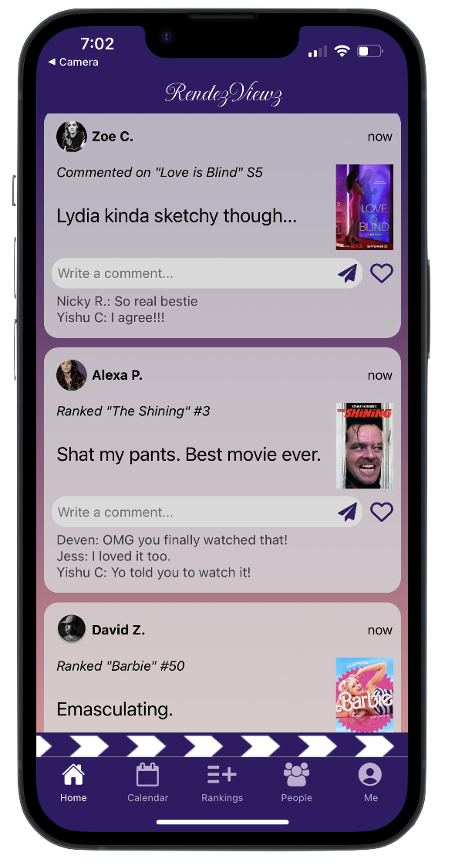
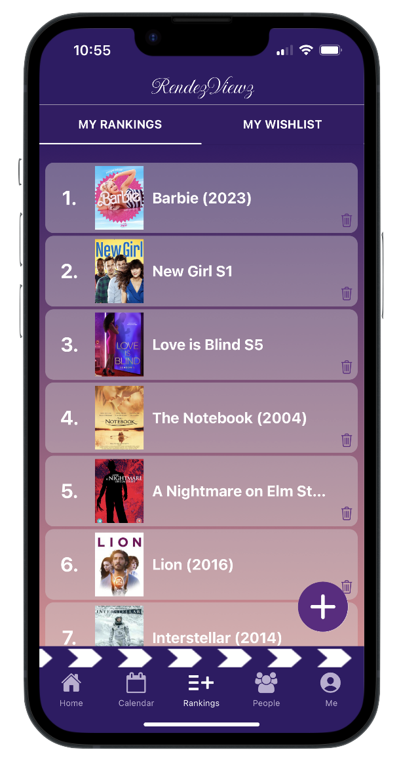
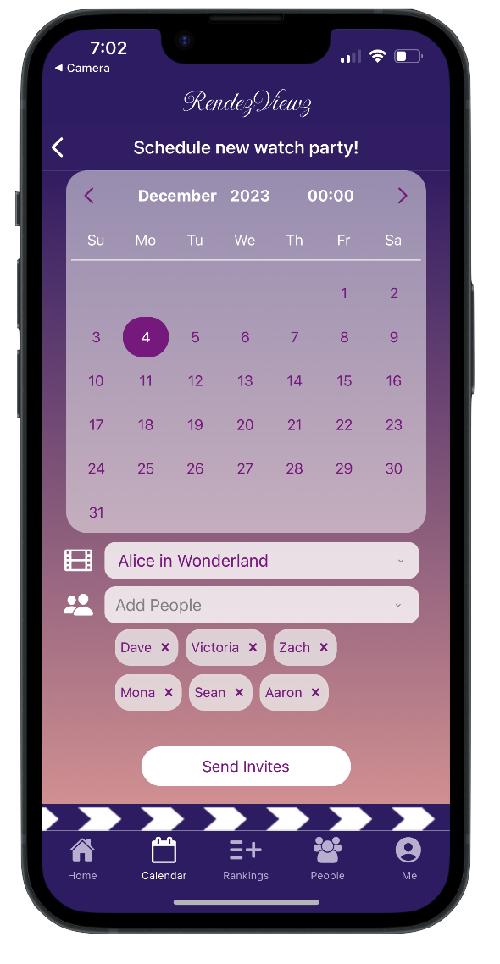
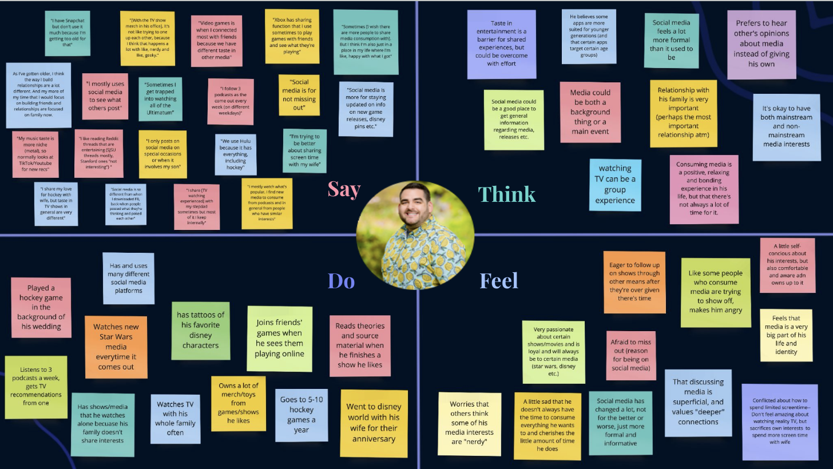
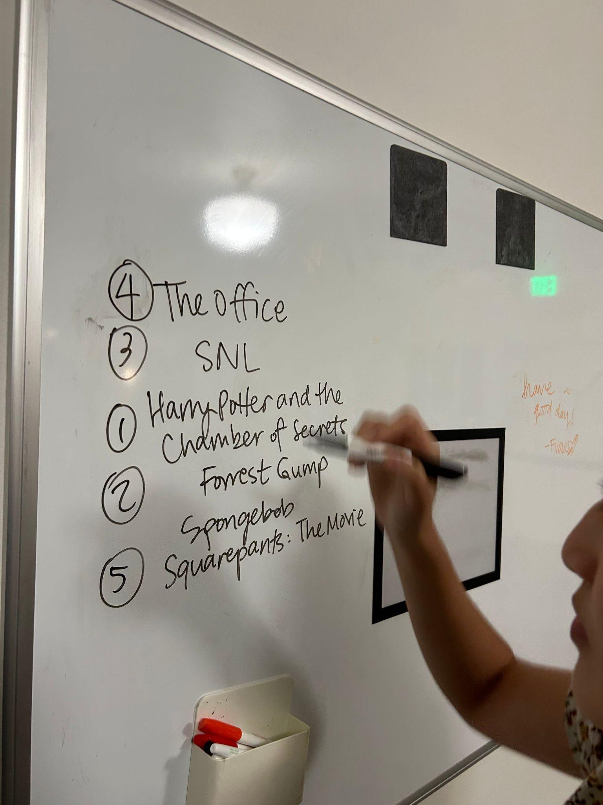
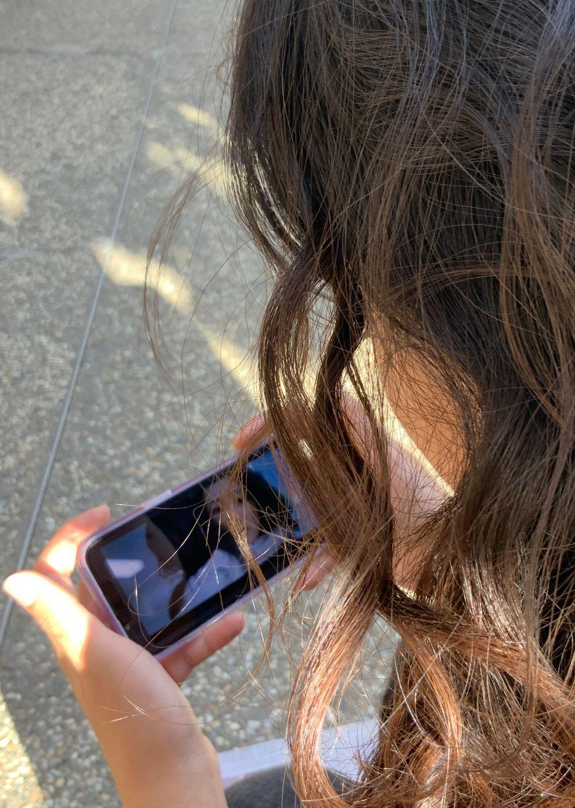
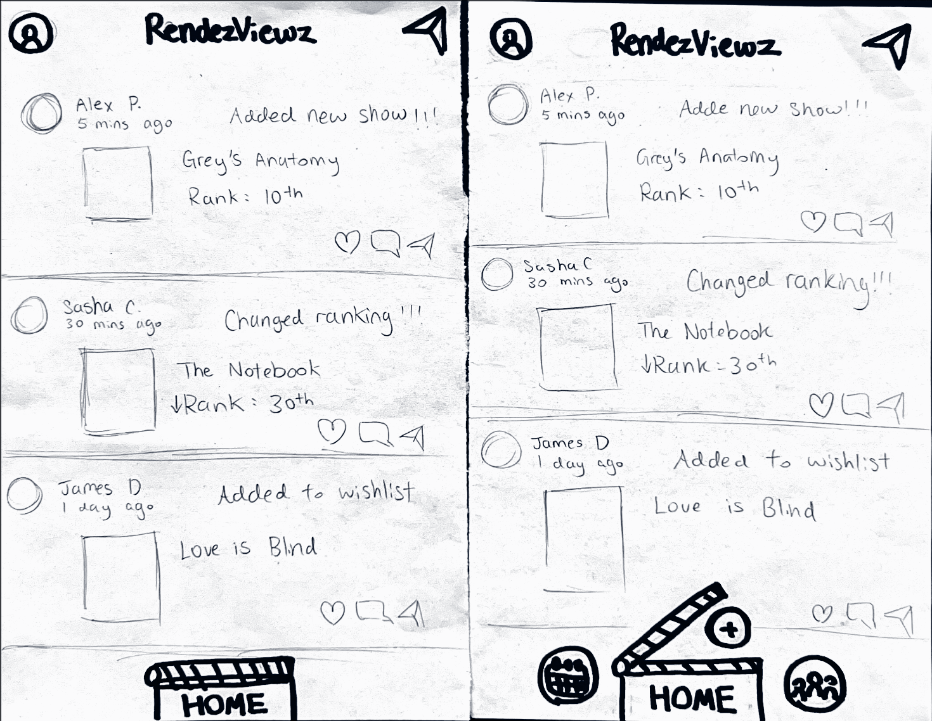
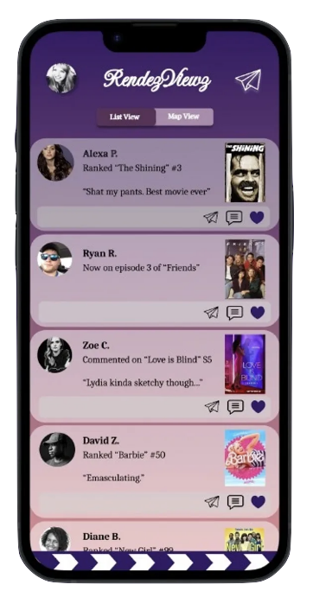
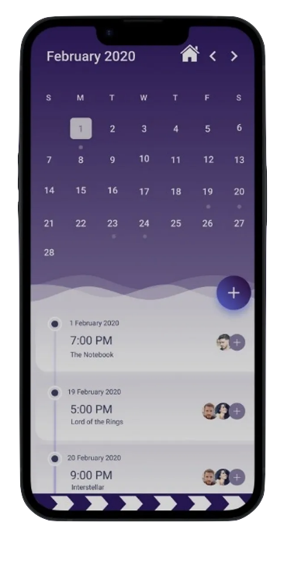
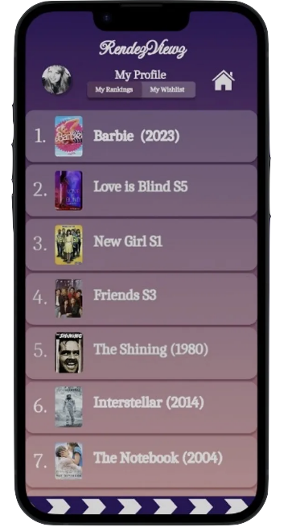
RendezViewz
Problem
It’s hard to facilitate meaningful, small-scale social experiences surrounding all types of entertainment content.
~Life of the watch party~
Solution
Casual and intimate show + movie ranking and watch party scheduling mobile app.
Value Proposition
Empowering shared show + movie exploration and seamless watch parties
See how your friends rank shows
Add and rank movies you’ve watched
Easily schedule watch parties
Needfinding
2. Testing
3. Low-fi
4. Medium-fi
Allen N., Charlotte Z., Francis S., Yishu C. | CS147 Autumn 2024 | https://web.stanford.edu/class/cs147/projects/ThreadsandTrends/RendezViewz/

